Slide 1

“Fair settlements come from knowledge and negotiation.”

Slide 2

Introduction
One of the riskiest and least manageable facets of an auto loan portfolio is the impact of total loss incidents and associated insurance claim collections.
Auto Claim Specialists can help reduce and manage this risk. This presentation will show how we do it.

Slide 3
Outline
  What is a total loss?
  Example of turning a certain charge off and likely lost customer into a potential new loan.
  How we do it (Lender Resolution Process)
  How we can impact your annual bottom line

Slide 4
What Constitutes a Total Loss?
State Total Loss Criteria
Total Loss Formula 22 States
Total Loss Threshold 28 States
100% Threshold 2 States (TX, CO)
80% Threshold 3 States
75% Threshold 16 States
70% Threshold 4 States
<70% Threshold 3 States (Min 50% - IA)

Slide 5
What Constitutes a Total Loss?
TRANSPORTATION CODE CHAPTER 501. CERTIFICATE OF TITLE ACT
SUBCHAPTER E. NONREPAIRABLE AND SALVAGE MOTOR VEHICLES
Sec. 501.091. DEFINITIONS. In this subchapter:
…
(8) "Motor vehicle" has the meaning assigned by Section 501.002.
(9) "Nonrepairable motor vehicle" means a motor vehicle that:
(A) is damaged, wrecked, or burned to the extent that the only residual value of the vehicle is as a source of parts or scrap metal;
…
(15) "Salvage motor vehicle" means a motor vehicle that:
(A) has damage to or is missing a major component part to the extent that the cost of repairs, including parts and labor other than the cost of materials and labor for repainting the motor vehicle and excluding sales tax on the total cost of repairs, exceeds the actual cash value of the motor vehicle immediately before the damage;

Slide 6
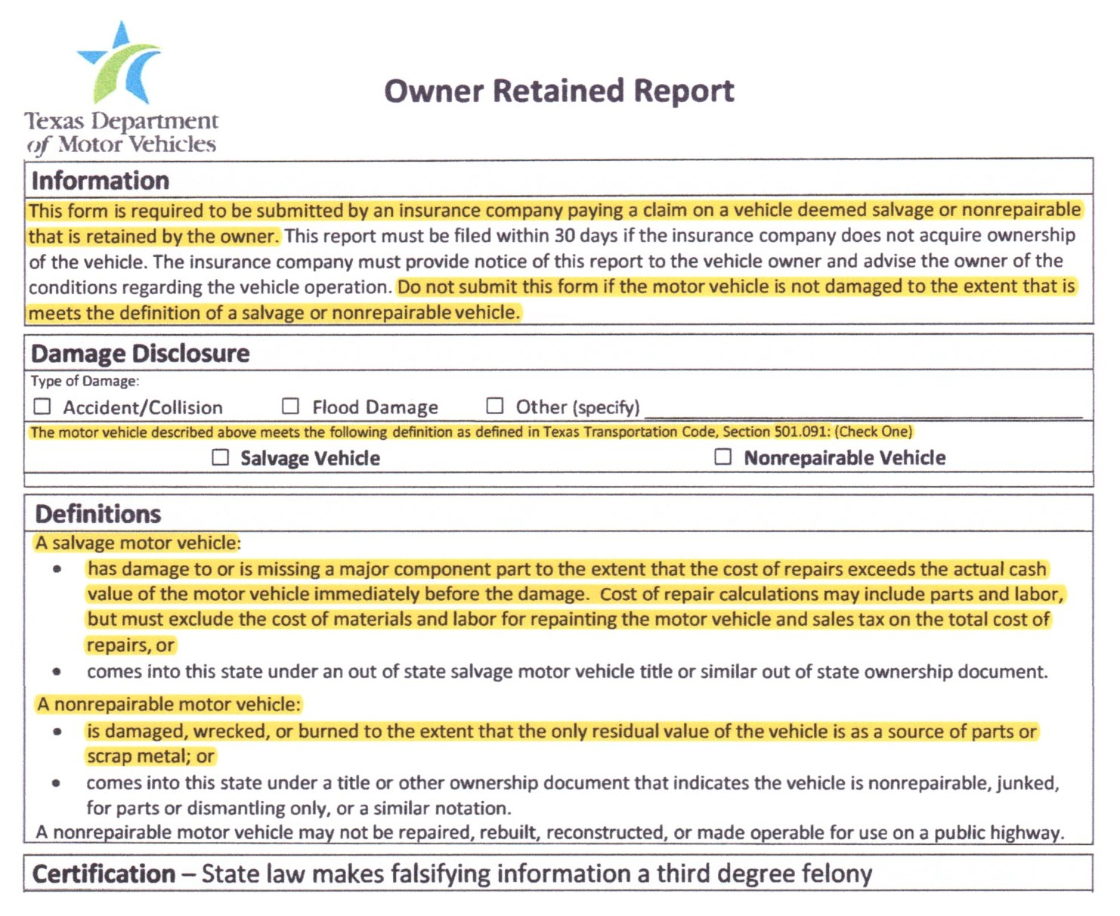
What Constitutes a Total Loss?

Slide 7
Settled Appraised ACV vs Market Valuation Report
Age | % of Claims | Average $ Difference | Average % Difference | Maximum $ Difference
ALL | 100% | $3,116 | 27.7% | $17,758
0-2 | 13.1% | $3,543 | 11.9% | $8,749
3-5 | 23.5% | $3,047 | 13.6% | $7,725
6-8 | 14.4% | $2,516 | 23.4% | $7,591
9-11 | 24.2% | $3,630 | 30.6% | $17,758
12-14 | 19.0% | $2,739 | 34.3% | $14,531
>14 | 5.9% | $2,215 | 84.4% | $4,650

Slide 8
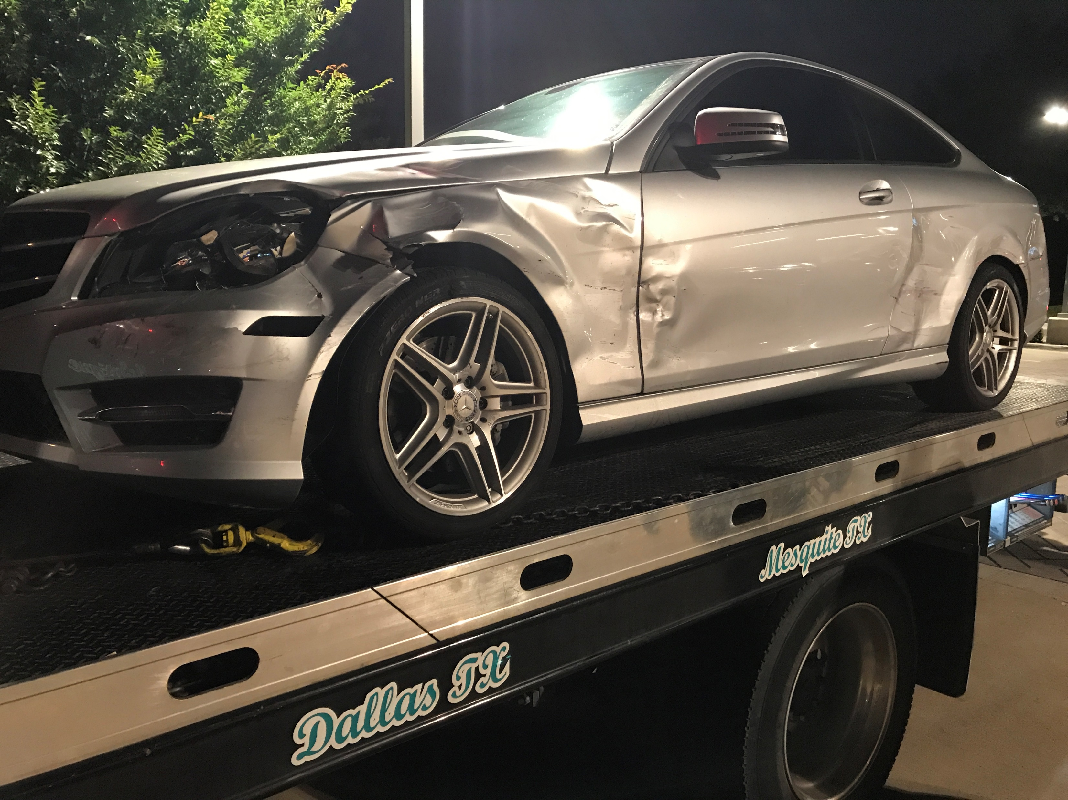
Example of a Positive Lender Resolution
2015 Mercedes-Benz C350
54 Remaining Payments of $707.00 @ 5.9%
Lender had $4,708.27 Remaining in Unearned Finance Charges
Payoff at Total Loss of $33,469.73

Slide 9
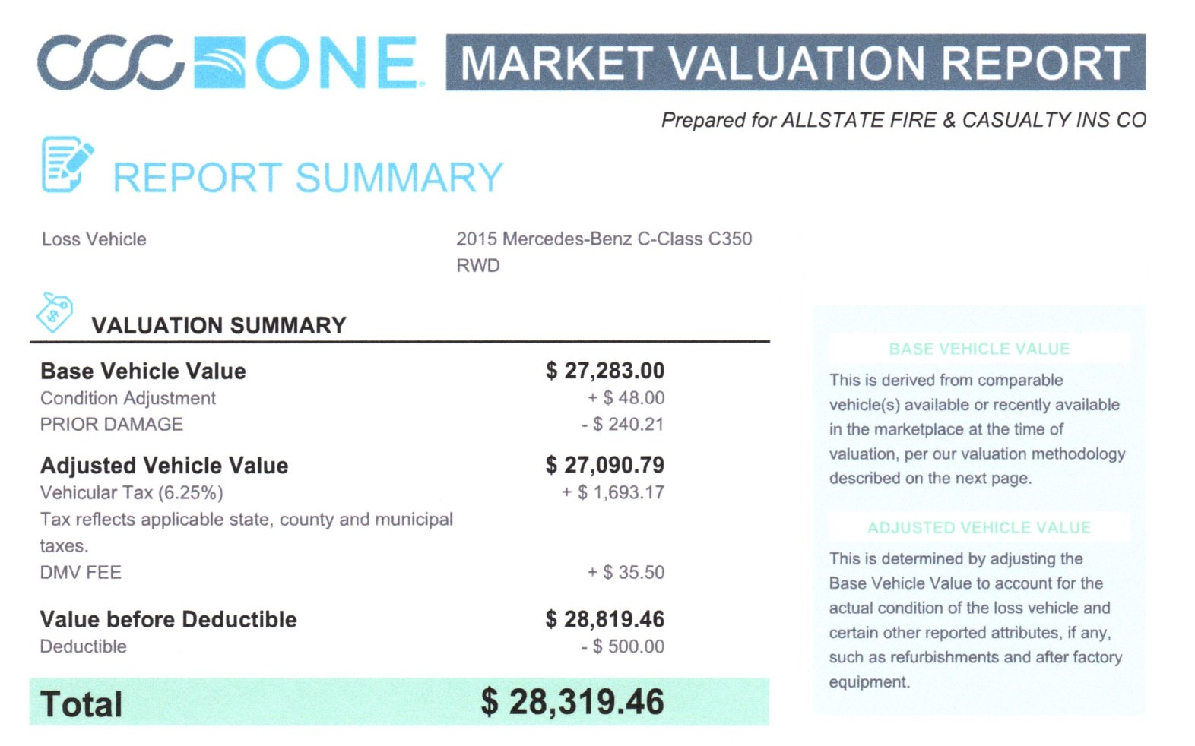
Example of a Positive Lender Resolution

Slide 10
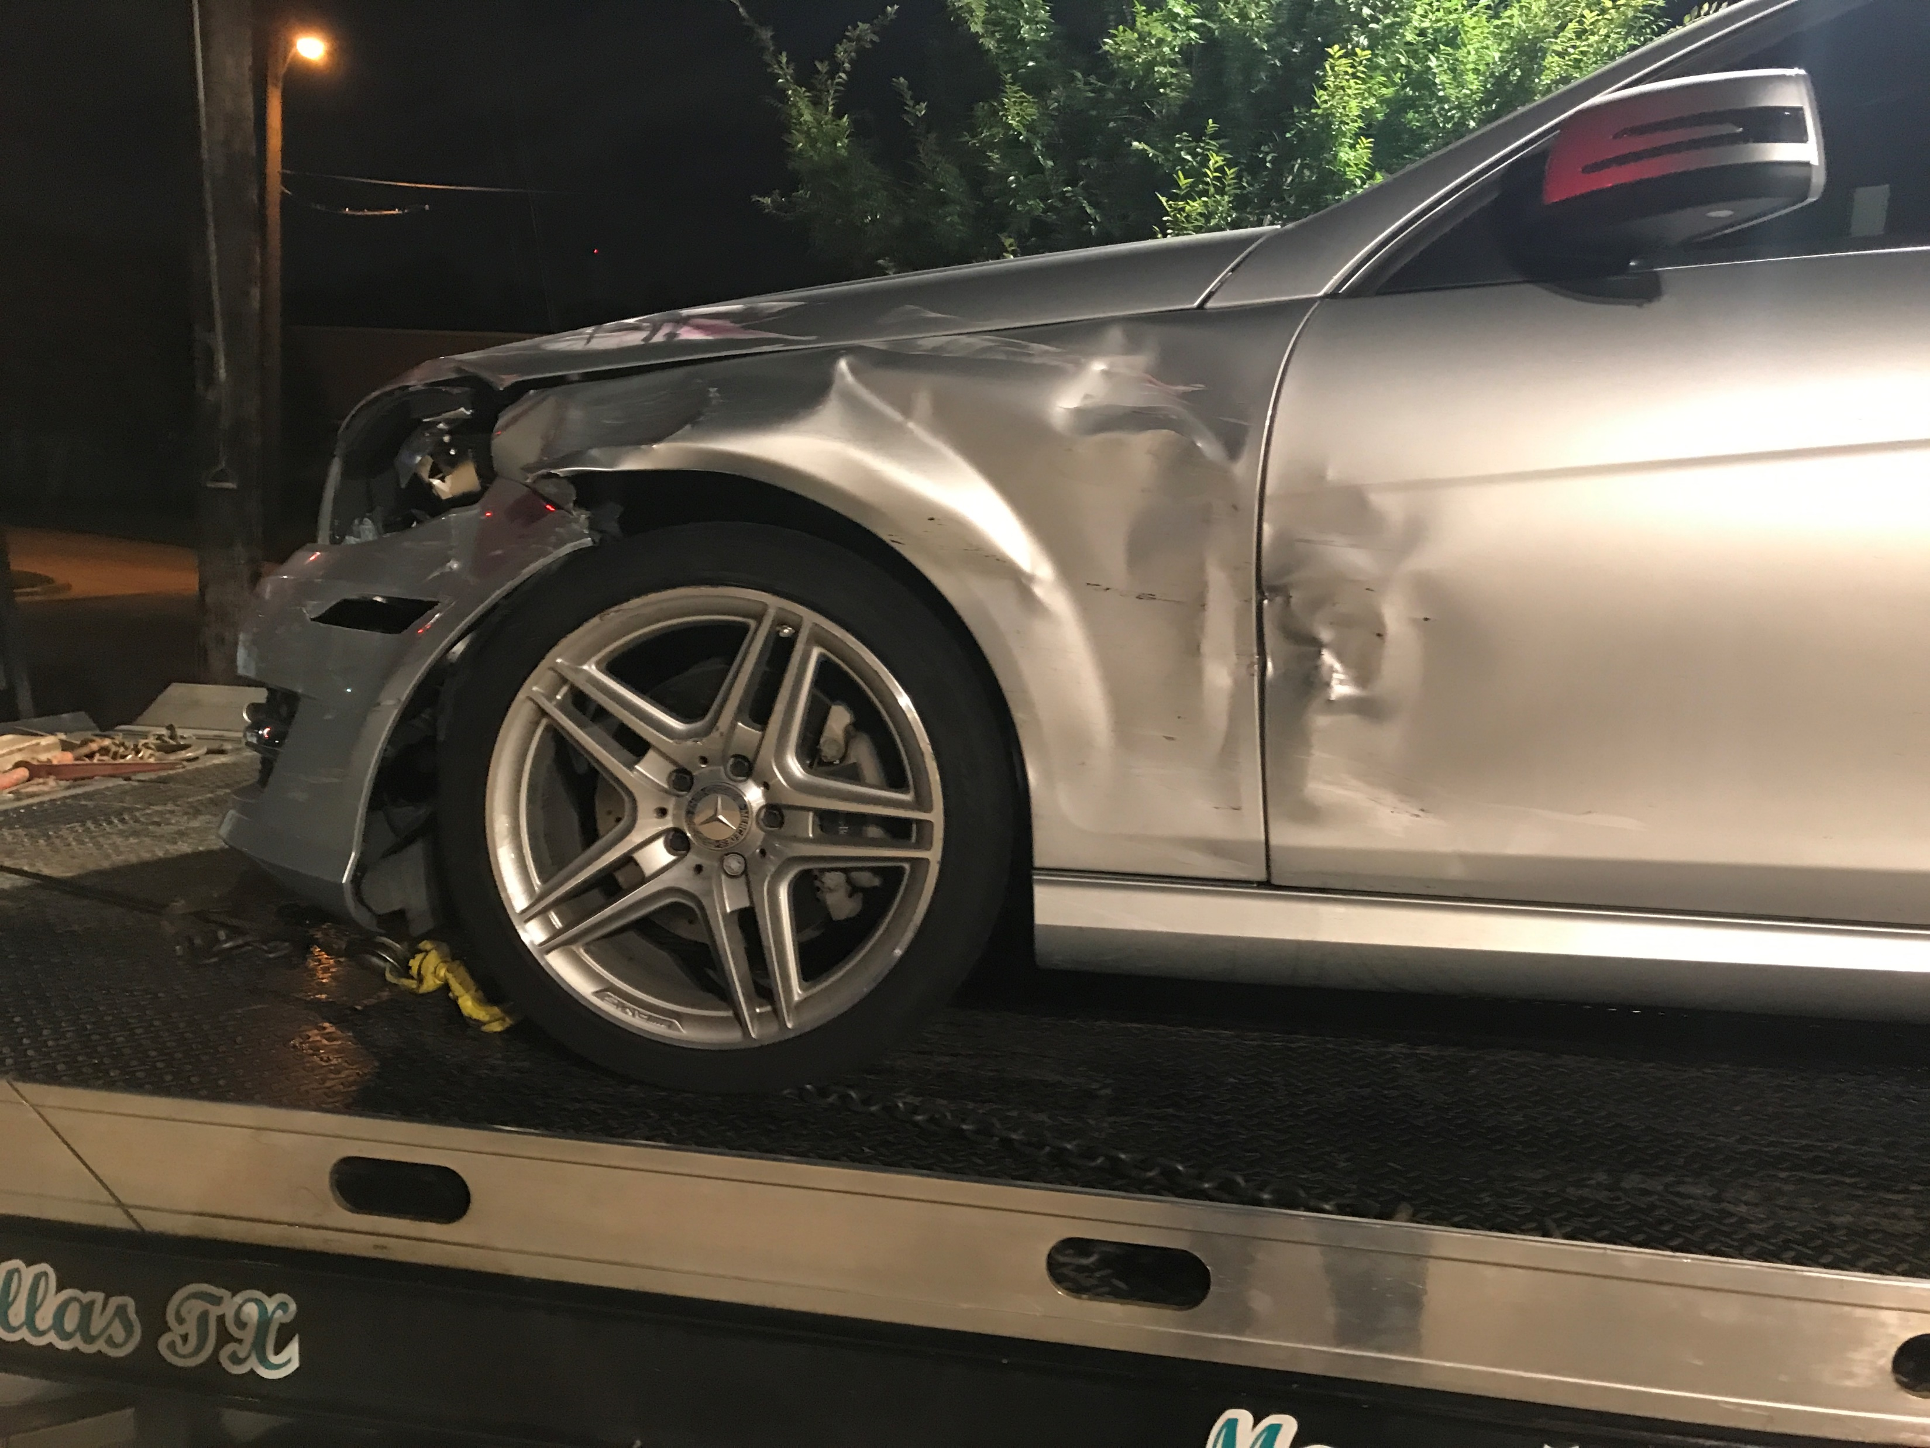
Example of a Positive Lender Resolution
Without Auto Claim Specialists
Settle Offer: $28,319.46
Payoff: $33,469.73
Charge off: $5,150.27
Lender loses $, client and potential future loan income from client

Slide 11
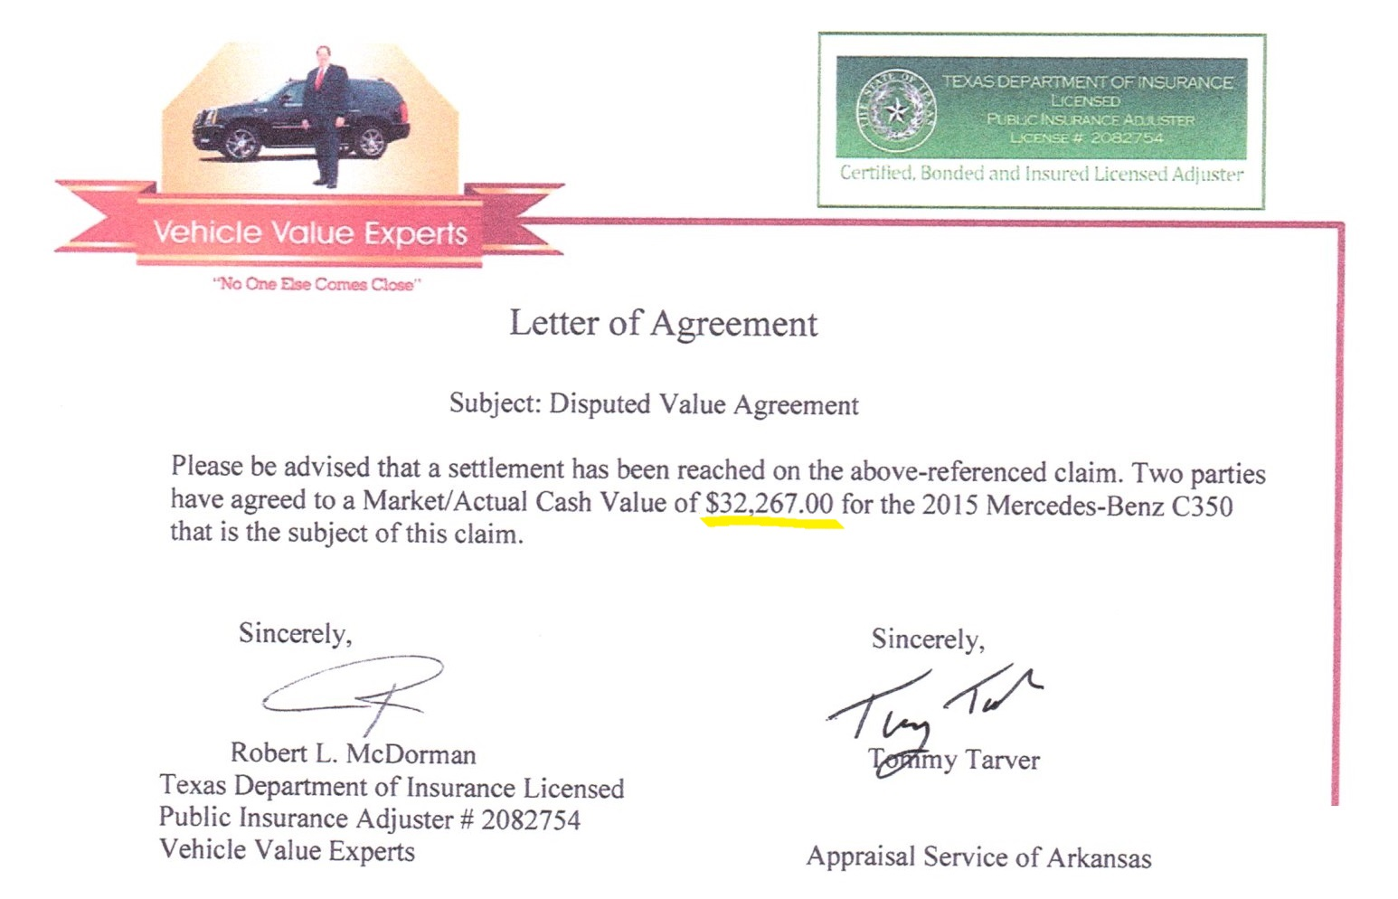
Example of a Positive Lender Resolution

Slide 12
Example of a Positive Lender Resolution
With Auto Claim Specialists:
Award*: $33,783.68
Payoff: $33,469.73
Balance: $313.95
Lender receives full payout and retains client
Balance of $313.95 available as down payment on a new car, resulting in a potential new loan with option to sell after market products such as GAP, Credit Life, Disability and Service Contract
*ACV $32,267 + Sales Tax $2,016.68 less deductible $500.00

Slide 13
Lender Resolution Process
Automobile Owner
Lender
Auto Claim Specialists
Lender Resolution Process
Auto Claim Specialists
Market Valuation Report
Insurance Carrier
Vehicle Value Experts
Umpire
Third Party Appraiser
Agreed Value

Slide 14
Lender Resolution Process
Where process starts and typically ends:
1A. Vehicle is towed to wrecker’s storage facility:
Wrecker sends notification to owner and lender.
Owner notifies insurer of accident and location of vehicle.
Insurer sends out an appraiser to storage facility.
1B. Vehicle is towed to an auto body facility:
Insurer sends an appraiser or uses the auto body facility estimate.
2. Based on estimate and Market Valuation Report, if deemed a total loss, insurer requests a payoff from the lender.
Insurer sends Declaration of Total Loss and Settlement Offer to the vehicle owner. Settlement offer is typically less than payoff, resulting in a deficiency charge off, with little or no recourse to the lender.

Slide 15
Lender Resolution Process
NOTE: In almost every instance, the lender knows that a vehicle has been deemed a total loss before the owner or body shop.
1A. Vehicle is towed to wrecker’s storage facility:
Wrecker sends notification to owner and lender.
Owner notifies insurer of accident and location of vehicle.
Insurer sends out an appraiser to storage facility.
1B. Vehicle is towed to an auto body facility:
Insurer sends an appraiser or uses the auto body facility estimate.
Lender could intervene HERE or HERE
and contact owner or
Auto Claim Specialists.
2. Based on estimate and Market Valuation Report, if deemed a total loss, insurer requests a payoff from the lender.

Slide 16
Lender Resolution Process
Auto Body Facility
Estimate
Automobile Owner
Lender
Contract
Invoke
Appraisal Clause
Declaration of Total Loss and Settlement Offer
Payoff
Auto Claim Specialists
Market Valuation Report
Insurance Carrier
ACV Valuation
Fixed Fee
Fixed Fee
Certified Appraisal
Umpire
Vehicle Value Experts
Third Party Appraiser
Agreed Value

Slide 17
Lender Resolution Process
Auto Body Facility
Estimate
Automobile Owner
Lender
Contract
Invoke
Appraisal Clause
Declaration of Total Loss and Settlement Offer
Payoff
Auto Claim Specialists
Market Valuation Report
Insurance Carrier
ACV Valuation
Fixed Fee
Fixed Fee
Certified Appraisal
Umpire
Vehicle Value Experts
Third Party Appraiser
Agreed Value

Slide 18
Lender Resolution Process
Auto Body Facility
Estimate
Automobile Owner
Lender
Contract
Invoke
Appraisal Clause
Declaration of Total Loss and Settlement Offer
Payoff
Auto Claim Specialists
Market Valuation Report
Insurance Carrier
ACV Valuation
Fixed Fee
Fixed Fee
Certified Appraisal
Umpire
Fee
Fee
Vehicle Value Experts
Third Party Appraiser
Agreed Value

Slide 19
Lender Resolution Process
Auto Body Facility
Potential Order to Fix Car;
Lender Receives Full Payoff
Estimate
Amended Settlement Offer;
Lender Short Gap Reduction or Elimination;
Owner Credit Rating Preserved
Automobile Owner
Lender
Fee
Contract
Invoke
Appraisal Clause
Declaration of Total Loss and Settlement Offer
Payoff
Auto Claim Specialists
Market Valuation Report
Insurance Carrier
ACV Valuation
Fixed Fee
Fixed Fee
Certified Appraisal
Umpire
Fee
Award Letter
Fee
Vehicle Value Experts
Third Party Appraiser
Agreed Value

Slide 20
Impact On Your Bottom Line
We’ll develop Total Loss Frequencies
  For vehicles declared a total loss that could not be fixed, or that owners do not want fixed.
  For vehicles declared a total loss that could and should be fixed, and that owners want fixed.
We’ll show average Loss Reduction Per Total Loss with the help of ACS
  For vehicles declared a total loss that could not be fixed, or that owners do not want fixed.
  For vehicles declared a total loss that are instead fixed.
We’ll calculate Expected Loss Reduction Per Loan (Frequency * Loss Reduction)
YOUR TOTAL EXPECTED LOSS REDUCTION EQUALS THE EXPECTED LOSS REDUCTION PER LOAN TIMES THE SIZE OF YOUR PORTFOLIO.

Slide 21
Impact On Your Bottom Line
Total Loss Frequencies
Percent of Total Loss Claims (Vehicles < 7 Years Only)
% Claims Flagged % Total
Age % Claims Total Loss Loss Claims
Current-3 60% 7.5% 4.5%
4-6 40% 12.5% 5.0%
Total 9.5%
CCC Information Services, “What’s Driving Total Loss Frequency” (Q4 ‘14 – Q3 ‘15)

Slide 22
Impact On Your Bottom Line
Total Loss Frequencies
  Value Description Source
  .0575 Claim Frequency (per 100 vehicles per year) for collision claims A
  .0350 Claim Frequency (per 100 vehicles per year) for liability claims A
  .0925 Total Claim Frequency (per 100 vehicles per year)
  0.095 Probability of a claim being classified a total loss (vehicles < 7 years) Prior Slide
  .0088 Total Loss Frequency (per 100 vehicles per year, vehicles < 7 years)
  (0.0925 * 0.095)
  A Verisk Analytics, “Claims Frequency, Severity: What’s Behind the Rise?”

Slide 23
Impact On Your Bottom Line
Total Loss Frequencies
  Value Description Source
  50% Percent of claims wrongfully categorized as total loss B
  49% Percent of customers who want their totaled car fixed if given the choice B
  24.5% Percent of vehicles declared a total loss that could be fixed and that
  owners want fixed (.50 * .49)
  75.5% Percent of vehicles declared a total loss that could not be fixed or that
  owners do not want fixed (100% - 24.5%)
  COMBINING THE ABOVE:
  0.0066 Total Loss Frequency for vehicles declared a total loss that could not be fixed or that owners do not want fixed (.0088 * .755)
  0.0022 Total Loss Frequency for vehicles declared a total loss that could be fixed and that owners want fixed (.0088 * .245)
  B Vehicle Value Experts Database

Slide 24
Impact On Your Bottom Line
Total Loss Frequencies
  In Summary:
  You can expect 0.88% of the vehicles in your loan portfolio to have a total loss claim in any given year. (US Average)
  Breaking this percentage out:
  0.66% will have a total loss claim where the vehicle cannot be fixed or where the owner will not want the vehicle fixed.
  0.22% will have a total loss claim that, with the help of ACS, could be changed to a partial loss claim whereby you would retain the loan.

Slide 25
Impact On Your Bottom Line
2. Average Loss Reduction per “Total Loss”
  Value Description
  $2,418 Expected loss reduction per totaled vehicle that could not be fixed or that owner does not want fixed
  $3,116 Average ACS Increased Value (Saved Lender Charge-Off)
  - $698 ACS Fee ($75 + 20% of Increased Value)
  $2,418
  $5,358 Expected loss reduction per vehicle that is initially totaled, but ends up being fixed with help of ACS
  $4,850 Saved Principle Charge-Off*
  +$1,206 Saved Loss of Unearned Finance Charges**
  $6,056 Total Savings
  - $698 ACS Fee ($75 + 20% of Increased Value)
  $5,358
*Vehicle Value Experts Database, Average Negative Equity Position
**See next slide.

Slide 26
Impact On Your Bottom Line
2. Average Loss Reduction per “Total Loss”
  Saved Loss of Unearned Finance Charges Calculation:
  New Car Used Car Source
  Average Loan Amount $30,621 $19,329 A
  Average Term 68 Months 63 Months A
  Average Rate 4.74% 8.50% A
  Remaining Interest at half-way point $1,153.63 $1,241.59 B
  Typical Portfolio Mix 41% 59% C
  Weighed Average Remaining Interest at Half-way Point:
  (.41 * $1,153.63) + (.59 * $1,241.59) = $1,205.53
  A Experian Survey, “State of the Automotive Finance Market,” Q4 2016
  B Amortization table based on above loan information
  C Dominion Dealer Solutions

Slide 27
Impact On Your Bottom Line
3. Expected Loss Reduction Per Loan
  Value Description
  $15.96 Expected Loss Reduction Per Loan for unfixed totaled vehicles
  (0.0066 * $2,418)
  $11.79 Expected Loss Reduction Per Loan for fixed vehicles that would have been totaled
  (0.0022 * $5,358)
  $27.75 Total Expected Annual Loss Reduction Per Loan
  NOTE: If you are in a more rural area, where Total Loss Frequency might be twice the national average, your annual loss reduction per loan could be double this amount.

Slide 28
Impact On Your Bottom Line
Example: 1000 Loan Portfolio
Expected Annual Loss Reduction: 1000 * $27.75 = $27,750
Expect approximately 9 total losses per year
Average negative equity position = $4,850
Anticipated Charge-Off Expense = $4,850 * 9 = $43,650
Charge-Off Reduction from Auto Claim Specialists:
  2 (24.5%) cars fixed 2 x $5,358 = $10,716
  7 cars totaled 7 x $2,418 = $16,926
  $27,642
Actual Charge-Off Expense = $43,650 - $27,642 = $16,008
63% Reduction in Charge-Off Expense

Slide 29
Simple Step to Achieve These Benefits
Auto Body Facility
Recommendation to Call Auto Claim Specialists
Potential Order to Fix Car;
Lender Receives Full Payoff
Estimate
Amended Settlement Offer;
Lender Short Gap Reduction or Elimination;
Owner Credit Rating Preserved
Automobile Owner
Lender
Fee
Contract
Invoke
Appraisal Clause
Declaration of Total Loss and Settlement Offer
Payoff
Auto Claim Specialists
Market Valuation Report
Insurance Carrier
ACV Valuation
Fixed Fee
Fixed Fee
Certified Appraisal
Umpire
Fee
Award Letter
Fee
Vehicle Value Experts
Third Party Appraiser
Agreed Value

Slide 30
What Else We Do for Lenders
Auto Claim management for damaged repossessed vehicles.
Diminished Value Claim Settlement

Slide 31

Q&A
“Fair settlements come from knowledge and negotiation.”
Visit our website at autoclaimspecialists.com

